Slide 1
CSPS-EFPC Digital Academy - l’Académie du numérique DevOps Cloud Native Stream May 1 2019 Jeff Barnes Cloud Services Directorate

Slide 2
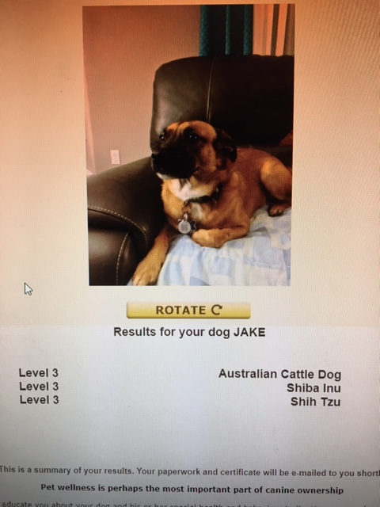

$whoami
SSC CSD Container Strategy
Senior Advisor recently landed in the SSC Cloud Services Directorate to help with a Container Strategy. Typical (one assumes) GC CS Career
As part of a Master’s program in 2015, started to examine digital transformation
Included the role and value of containers, orchestration, DevSecOps, CI/CD
On a mission to increase the pragmatic adoption of DevSecOps methods and patterns in the GC
CSPS DAAN helps address learning curve associated with Cloud Native Development (sow and grow)
An imposter when it comes to CI/CD, will stand on the shoulders of the giants - CSPS Fellows
Pedestrian examples when learning this myself (in case it helps)
https://github.com/jeffbarnes769/hello
https://github.com/jeffbarnes769/multi2
https://github.com/jeffbarnes769/hello3
Beware of doge
Notes:
Operational support, some development, then Networking, Security, Windows, Exchange, Telecommunications
Doge is an Internet meme that became popular in 2013. The meme typically consists of a picture of a Shiba Inu

Slide 3
DevOps Stream Recap
SSC CSD Container Strategy
CSPS DAAN DevOps Stream introduces the ecosystem of Culture (behaviours) → People → Process → Tools (platforms) that can ‘more’ securely increase deployment cadence and application migration, including:
DVCS, GIT and GITHUB, Kubernetes and CNCF Ecosystem
Achieving faster delivery while lowering risk - CI-CD demo (ESDC).pptx
Compliance, Accessibility and other great sessions
Implemented together, these components influence culture and behaviour, which in turn enables digital transformation and creates highly effective organizations:
Automation – for anything that is difficult or repetitive
Shift left – quality through shared understanding
Transparency – communication of purpose and intent
Standardization – drive savings, sharing, efficiency
Compliance – design and include those teams upfront
Knowledge sharing – runbooks, releases, education
Collaboration
Remediate the impact of Conway’s Law: ‘organizations which design systems ... are constrained to produce designs which are copies of the communication structure of these organizations.’ Melvin Conway (1967)
Notes:
https://www.webagesolutions.com/wp-content/uploads/2019/04/DevOps-for-Managers-%E2%80%93-Chapter-2-WA2593.pdf
https://en.wikipedia.org/wiki/Conway%27s_law
Culture (behaviours) → People → Process → Tools

Slide 4
SSC Container Strategy
SSC Cloud Services Strategy
The SSC Cloud Services Directorate (CSD) Container Orchestration Framework aligns with Cloud Native and DevOps streams. The framework provides a roadmap based on current GC guidance and guardrails to help SSC and partners to deploy applications securely and consistently when using containers
Shared Responsibility Model
IaaS
PaaS
SaaS
Cloud security and compliance is a shared responsibility, where the cloud provider and the tenant each have a role to play.
Educate participants and stakeholders of roles and responsibilities between CSP and customer
Knowing what security controls the vendor provides allows the business to take steps to secure their own cloud environment and ensure compliance.
As organizations migrate applications to the cloud (rehost, refactor, lift and shift…) ensure security and compliance is maintained
Data
Data
Data
Applications
Applications
Applications
Platform
Platform
Platform
Resource Abstraction
& Control
Resource Abstraction
& Control
Resource Abstraction
& Control
Hardware
Hardware
Hardware
Facility
Facility
Facility
Platform Ops/CSP Managed
Developer/Partner Managed
Source: Gartner, April 2016

Slide 5
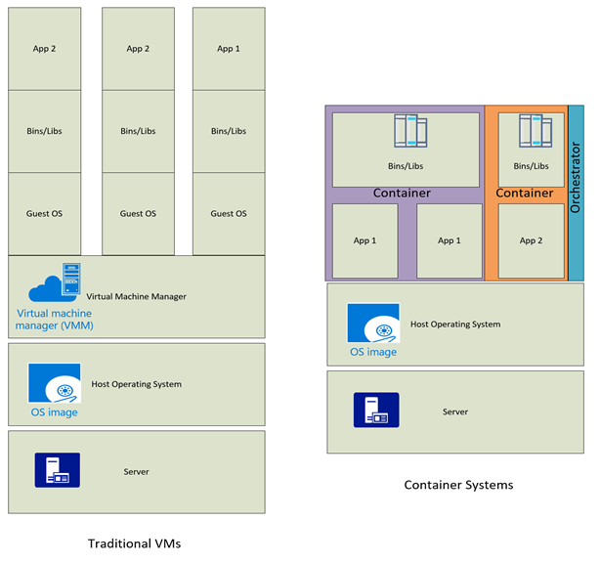
SSC Container Orchestration Framework
SSC Cloud Services Strategy
Cloud Services Directorate will enable the Government of Canada’s Digital Strategy by providing a Container Orchestration Framework that includes managed platform services hosted within SSC EDC’s and guidance for public cloud workloads
This will provide partners a consistent application deployment strategy decoupled from location
The service will support up to and including PBMM data and workloads
SSC CSD will enable containers via enterprise-ready orchestration platforms, including OpenShift and Pivotal Cloud Foundry, in support of an overall GC Cloud Strategy.
Consistency in application deployment across multiple platforms, including options for transforming legacy applications to cloud native application architecture
Simplified use of multiple frameworks languages and DB’s
Abstraction of infrastructure from the application, especially platform management
Resiliency and scalability platform for application deployment
Base security controls will be implemented in the platform, reducing partner application SA&A requirements due to inheritance
Allow partners to choose application migration and packaging methods based on requirements
Virtual Machines vs Containers
Provider
Notes:
These platforms will include guidance and integration with foundational elements such as image scanning, continuous integration/continuous deployment, load balancing and other 12-factor requirements.

Slide 6
SSC Container Orchestration Framework
SSC Cloud Services Strategy
OpenShift and Pivotal Cloud Foundry both provide significant additional value when deploying containers. Cloud orchestration simplifies deployment and management of applications using containers consistently and declaratively. It does this by:
Building an abstraction layer between resources and service requirements, such that resources can be autoscaled when required during build and deployment. If an application is already designed to run in containers, it’s a fairly easy uplift to deploy to PaaS
Inherent security in the implementation, such as traffic paths between nodes are encrypted and use mutual authentication, applications in PaaS do not run as root/require root access
PaaS follows DevOps tenets per GC Guidance on Secure Containers and Microservices: image provenance, secure image registry, CVE ( Common Vulnerabilities and Exposures) scanning, immutability (rather than patching), assessment against the CIS Docker benchmark,…
Reduced time to ATO/SA&A since the PaaS provides/meets many of the required controls
PaaS allows developers to follow the microservice tenants per GC Cloud Reference architecture (‘strangle the monolith’)
Applications on PaaS requires fewer VM’s than a non-container implementation
Avoid challenges and unmet expectations when deploying to Containers without Orchestration
Orchestrators help scaling when deploying to containers and avoid DIY Complexity
Help avoid licence rights when using straight OSS (Open Source Software) stack in GOC
Potential challenges to address when deploying applications to PaaS with containers
Learning uplift (remediate through training, Digital Academy…)
Best fit (remediate by building to PaaS as a first-class citizen, publishing design patterns, making PaaS best use case)
Provider
Notes:
GC Guidance
DRAFT Guidance for Secure Application Development
DRAFT Guidance for Secure Containers and Microservices
DRAFT Security Controls Mapping to Docker and Kubernetes
GC Cloud Reference Architecture (Draft 0.95)
Directive on Management of Information Technology - C.2.3.10.4 Run applications in containers

Slide 7
SSC Container Orchestration Framework
SSC Cloud Services Strategy
SSC CSD will enable containers via enterprise-ready orchestration platforms, including OpenShift and Pivotal Cloud Foundry, in support of an overall GC Cloud Strategy.
Simplify use of various frameworks, languages and databases when deploying workloads
Simplify container deployment, resiliency and scaling, including hard and soft multi-tenancy
Integrate with partner deployment tools (CI/CD)
Provide base features (image repository, scanning)
Reduce time for monitoring and provisioning through application and platform Health checking
Ability to run both stateful and cloud-native stateless applications simultaneously
Provisioning procedures that enable an open source architecture across various platforms (on and off-prem)
Uses open standards; such as Open Container Initiative, Container Network Interface (CNI) and Container Storage Interface (CSI)
Command-line functionality tools and multi-device web console facilitation container orchestration.
Controls are applied to the platform and inherited by the application owner, reducing effort and time to complete an ATO and SA&A (Authority to Operate / Security Assessment and Authorization)
Platforms enable overall CSD Cloud Strategy:
Based on GC guidance for containers and Microservices
Validate integration with CMP and Salesforce
Leverage foundational services (IPAM, Authentication and authorization)
Built on current CSD pathfinders on and off-premises (including Azure Stack, Britesky and Pivotal reference Architecture)
Integrate with partner deployment tools
Provider

Slide 8
SSC Container Orchestration Framework
SSC Cloud Services Strategy
Implement the container orchestration framework as release blocks, starting with guidance and guardrails
 | Objectives | Execution Guidelines
Program Release Block - 0 | Recommend guardrails, a golden design and guidance when using acceptable alternatives (with conditions) for application deployment as the SSC Container Service is provisioned | To provide consistent and repeatable guidance for all strategy fronts for partner workloads, while the SSC Container Framework is deployed. Includes guidance on foundational services, use case, 1st draft for a ConOps
Program Release Block - 1 | Provision and deploy Code and Image Repository for partner workloads, and guidance when using acceptable alternatives. Includes recommendations for container security | To deploy a source code repository and container image repository for partner workloads; and acceptable alternatives based on guidelines and guardrails
Program Release Block - 2 | Provide a CI/CD service, and guidance when using acceptable alternatives | Provide an internal CI/CD service for partners who request it; and acceptable alternatives based on guidelines and guardrails
Program Release Block - 3 | Design and deploy OpenShift, foundational services, complete base SA&A, ATO; partner instructions for application deployment | Use case, ConOps. foundational services, instructions, cost models
Program Release Block - 4 | Design and deploy Pivotal Cloud Foundry, foundational services, complete base SA&A, ATO; partner instructions for application deployment | Use case, ConOps. foundational services, instructions, cost models
Program Release Block - 5 | Design and deploy an on-prem cloud native deployment platform | Design and deploy an on-prem cloud native deployment platform, including service mesh and functions as a service
Program Release Block - 6 | Continue to iterate on a cloud-native platform, hybrid or multi-cloud as required | Evaluate partner use and use cases, examine service offerings and environment as options evolve
Provider

Slide 9
SSC Container Orchestration Framework – Expected Deliverables
SSC CSD Container Strategy
Container Orchestration Framework
2018 – 2019
Q1 | Q2 | Q3 | Q4
2019 – 2020
Q1 | Q2| Q3 | Q4
2020 – 2021
Q1 | Q2 | Q3 | Q4
2021 – 2022
Q1 | Q2 | Q3 | Q4
Block 0 –Guardrails and Guidance
Iterative
Ongoing
Block 1 – Code and Image Repo
Iterative
Ongoing
Block 2 – CI/CD Recommendations
Iterative
Ongoing
Block 3 - Platform Deployment OpenShift
Iterative
Ongoing
Block 4 – Platform Deployment PCF/PRA
Iterative
Ongoing
Block 5 – On Prem Cloud Native platform
Iterative
Ongoing
Block 6 – Iterate on suite of offerings
Iterative

Slide 10



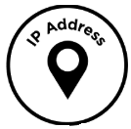
Container Orchestration Framework – Enabler Service
SSC CSD Container Strategy
Container service will use traditional and cloud native foundational services (as they evolve)
These services enable cloud native application deployment on partner journey to public cloud
Active Directory
Service Principals
Sidecar Proxy
Micro-Segmentation
Container Security Brokers
Platform based RBAC
Secrets storage
mTLS
Cloud Native Foundational
Services
Software defined networking
Policy Based Routing
Eventual Service Mesh
RFC 6598
Service Discovery
Controller Ingress/Routing
Enabler

Slide 11
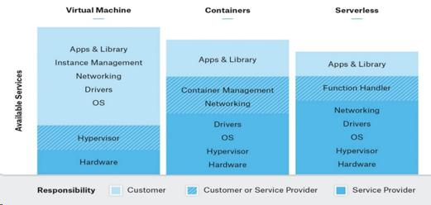
SSC Container Orchestration Framework
SSC Cloud Services Strategy
Release Block Discussion – Would like to hear from you
Do partners see value in SSC providing or recommending a specific CI/CD service, to accompany guidance when using acceptable alternatives
Appreciate your insight, features and requirements as part of the design and deployment of OpenShift, including foundational services, security, roles and responsibilities, and application deployment guidelines
Appreciate your insight, features and requirements as part of the design and deployment of Pivotal Cloud Foundry, including foundational services, security, roles and responsibilities, and application deployment guidelines
Challenge discussion on the utility of SSC providing partners with an on-prem cloud native deployment platform (Kubernetes, Service Mesh, Serverless)
What else is missing/should we add or be aware of?
Provider
Notes:
These platforms will include guidance and integration with foundational elements such as image scanning, continuous integration/continuous deployment, load balancing and other 12-factor requirements.

Slide 12

Questions and Discussion
SSC CSD Container Strategy
SOLUTIONS

Slide 13
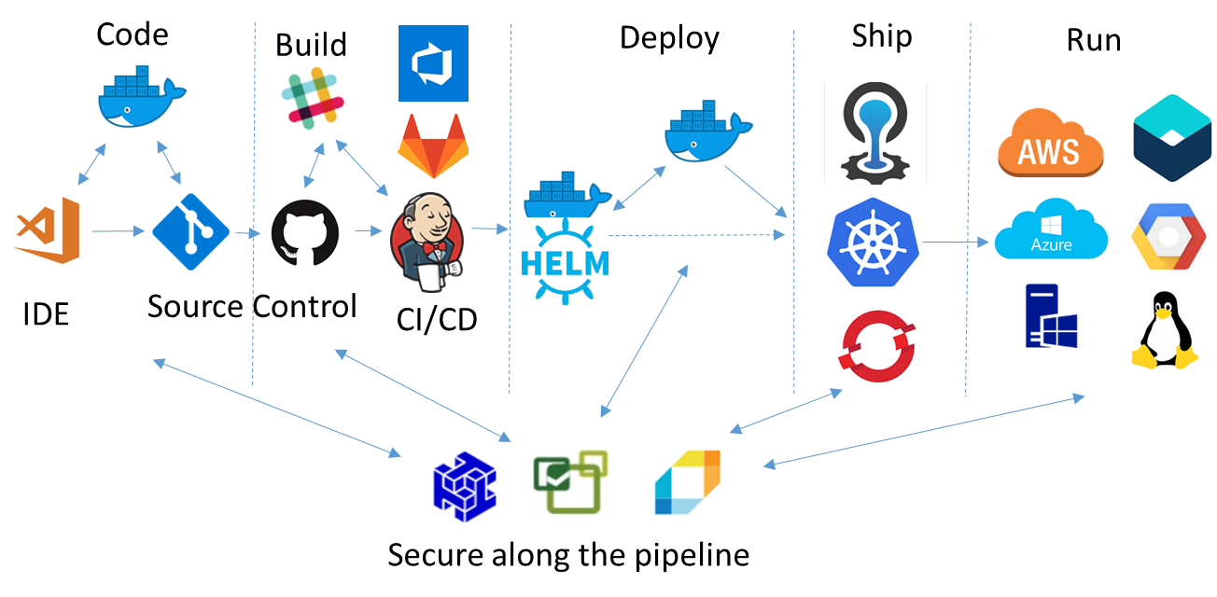
Appendix
SSC CSD Container Strategy
Example (only) deployment pipeline – intent is too recommend a ‘paved road’ or recommended design with included components, ATO’s etc., based on current GC Guidance. Deviation might require undifferentiated heavy lifting to achieve the same result (batteries included but replaceable)
SSC Container Orchestration Framework includes OpenShift and Pivotal Cloud Foundry

Slide 14
Appendix
SSC CSD Container Strategy
SSC Container Orchestration Framework based on OpenShift and Pivotal Cloud Foundry (PRA)
CSP | Azure | AWS | Google | IBM | Hosted (DIY –bare-metal or VM)
Platform
OpenShift | OpenShift on Azure | OpenShift on AWS | Red Hat OpenShift Container Platform | IBM Cloud Private with OpenShift | OKD, Origin
Cloud Foundry | Cloud Foundry on Azure | Pivotal Cloud Foundry on AWS | Pivotal Cloud Foundry | Cloud Foundry | Upstream CF, others
Kubernetes | AKS | Fargate EKS | GKE | IBM Kubernetes Service (Cloud Private Hosted) | Kubernetes The Hard Way, Kong, Diamanti
Kubernetes (on-Prem) | Azure Stack | Outpost | Anthos | IBM Cloud Private (ICP-CE)
Containers | ACI | ECS | GKE | IBM Cloud Kubernetes Service | OCI Compliant (i.e. Docker)
Serverless | Azure Functions | AWS Lambda | Google Cloud Functions | IBM OpenWhisk | Knative, OpenFaaS, Kubeless and others
Serverless (on-Prem) | Azure Stack | AWS Outpost (exp) | Google Cloud Run | ICP-CE + Knative
Notes:
Tyranny of choice

Slide 15
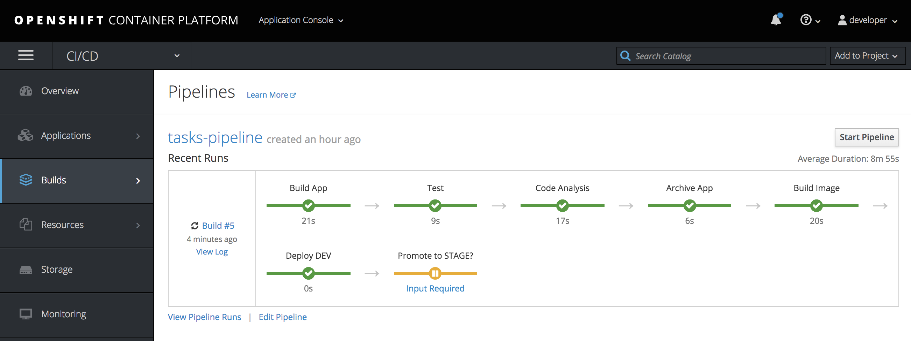
Appendix
SSC CSD Container Strategy
SSC Container Orchestration Framework - OpenShift
SSC will deploy managed OpenShift to allow partners to bring their own code and/or images to the platform. OpenShift platform contains private a
registry, ability to create deployment pipelines, health
monitoring, routing other features
Demo’s and deployment tips, i.e. configuring CI/CD
https://github.com/siamaksade/openshift-cd-demo
https://github.com/Microsoft/openshift-origin
https://about.gitlab.com/2017/05/16/devops-containers-gitlab-openshift/
Public OpenShift Resources for learning/dev (and access to free trial platform)
https://learn.openshift.com/introduction/

Slide 16
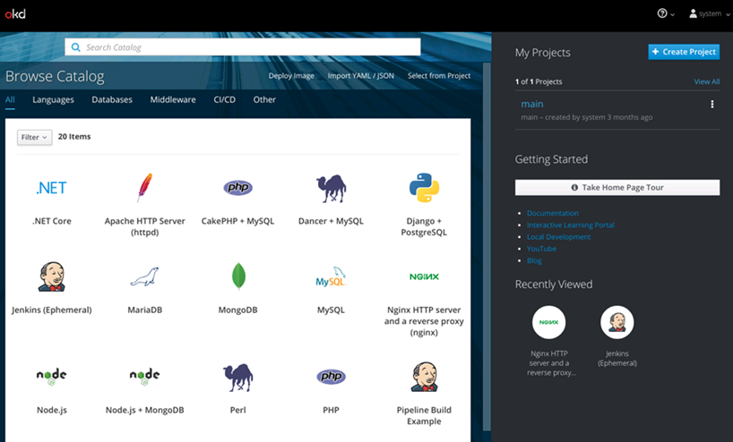
SSC Container Orchestration Framework
SSC CSD Container Strategy
Deployed on current internal hardware stacks and in all CSP, partners will be able to deploy applications to OpenShift using various and common methods (such as manifests). Use PaaS services to create application and/or bring your own container (BYOC)
Example installed via $oc cluster up
$oc login -u <user>
$oc new-project <project name>
$oc status
$oc get pods
Minishift

Slide 17
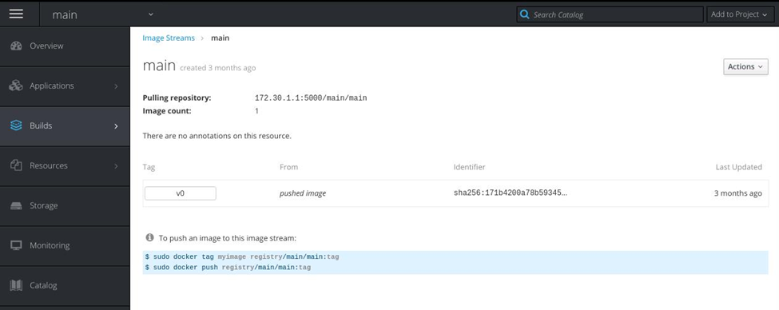
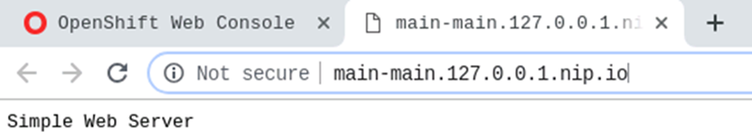
SSC Container Orchestration Framework
SSC CSD Container Strategy
BYOC - push container to OpenShift Registry, container is scanned for CVE vulnerability and runs as non-root per GC Guidance.
$ docker save -o main jeffbarnes/main:v0
$ docker load -i main
$ oc login
Authentication required for https://127.0.0.1:8443
Username: developer
Password:
Login successful.
You have one project on this server: "main"
Using project "main".
$ oc whoami -t
*******
$ docker login -u developer -p ******* 172.30.1.1:5000
Login Succeeded
$ docker tag jeffbarnes/main:v0 172.30.1.1:5000/main/main:v0
$ docker push 172.30.1.1:5000/main/main:v0
The push refers to repository [172.30.1.1:5000/main/main]
9e22f5b3b134: Pushed
v0: digest: sha256:5e1cacbb96a59c2a963a01849bb5923a9f1d9d02310dd8f4ab4654f717e6563d size: 739
$ oc get is
NAME DOCKER REPO TAGS UPDATED
main 172.30.1.1:5000/main/main v0 3 months ago

Slide 18
SSC Container Orchestration Framework
SSC CSD Container Strategy
Pivotal Cloud Foundry based on the Pivotal Reference Architecture
PCF DEV for learning/testing Pivotal Cloud Foundry for Local Development or available via pivotal.io or CSP
Cloud Foundry for Beginners: From Zero to Hero https://www2.thelinuxfoundation.org/e/6342/2018-03-21/3z26s5/862422452 Microservices on Cloud Foundry: Going Cloud Native https://www2.thelinuxfoundation.org/e/6342/2018-03-21/3z26s7/862422452 Operating a Platform: BOSH and Everything Else https://www2.thelinuxfoundation.org/e/6342/2018-03-21/3z26s9/862422452
PCF lexicon
Droplet – An archive that contains the application ready to run on Diego (the container management system in Cloud Foundry). A droplet is created as a result of the application staging process. It has a similar status to images in a production Docker registry.
Buildpack – The buildpack is the mechanism used to define which language dependencies to download. They provide structure and runtime support for apps as well as defining how to configure the apps to communicate with bound services resulting in ready to deploy applications.
cf push – The command used to upload a new app/sync changes to an existing app to Cloud Foundry.

Slide 19
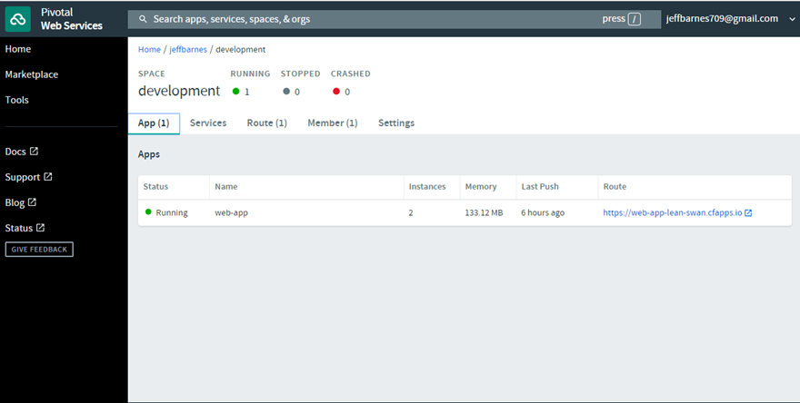
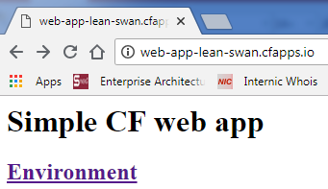
SSC Container Orchestration Framework
SSC CSD Container Strategy
SSC Container Orchestration Framework - Pivotal Cloud Foundry (PCF)
Applications can be pushed to PCF using platform services or as BYOC
$ cf login -a https://<tenant>.io/ -u <username>
API endpoint: https://<tenant>.io/
User: <username>
Org: <ORG>
Space: Development
$ cf push web-app
Scaling apps
$cf scale web-app -i 2
BYOC - For Diego based runtimes, run:
$cf enable-feature-flag diego_docker
$cf push main -o jeffbarnes/main:v0
Notes:
Notes on Ruby
https://github.com/RefugeRestrooms/refugerestrooms/wiki/What-is-Ruby%3F-What-are-Gems,-Gemfile,-and-Gemfile.lock%3F-Why-do-I-see-%22rb-this%22-and-%22.rb-that%22-everywhere-in-the-Refuge-Restrooms-GitHub-repo%3F
https://stackoverflow.com/questions/7517524/understanding-the-gemfile-lock-file
https://tosbourn.com/what-is-the-gemfile/

Slide 20
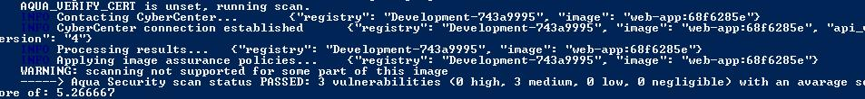
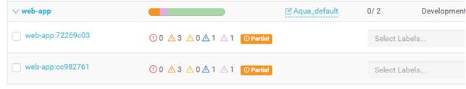
SSC Container Orchestration Framework
SSC CSD Container Strategy
Security brokers can scan an application image during push, in this example AquaSec PCF Tile
$ cf push web-app
Produces list of vulnerabilities, can pass or fail the build, provide firewall service, protects and secures services/images….
Example Security Controls (based on Cloud.gov – which is Cloud Foundry). CDS and other organizations actively working on automated compliance and compliance checking (see session on May 2)
https://cloud.gov/overview/security/fedramp-tracker/
https://www.fedramp.gov/assets/resources/documents/FedRAMP_Security_Controls_Baseline.xlsx
https://cloud.gov/resources/cloud.gov-CIS-Worksheet.xlsx
Notes:
https://github.com/opencontrol/compliance-masonry
https://www.open-scap.org/

Slide 21
SSC Container Orchestration Framework
SSC CSD Container Strategy
PCF Security requirements
Scan droplets for known vulnerabilities, based on an updated feed from multiple resources (public CVEs, vendor-issued, proprietary vulnerability data streams and malware lists)
Block unauthorized droplets from being uploaded to stores and ran based on droplets assurance policies, for example:
Stop unauthorized droplets
Stop droplets by CVEs and score
Detect and stop droplets with hardcoded secrets
Detect and stop droplets with malware
Add custom compliance checks
View actionable mitigation information on how to mitigate detected vulnerabilities
Gain visibility into droplet vulnerabilities directly from CI/CD tools and CSB dashboard

Slide 22
SSC Container Orchestration Framework
SSC CSD Container Strategy
Application Migration (Cloud Native)
The target application architecture can be influenced, or sometimes determined, by the cloud migration method selected. Common application migration methods include the five “Rs”:
Rehost - redeploy applications to a different hardware environment and change the application’s infrastructure configuration.
Refactor - run applications on a cloud provider’s infrastructure.
Revise - modify or extend the existing code base to support legacy modernization requirements, then use rehost or refactor options to deploy to cloud.
Rebuild - rebuild the solution on PaaS, discard code for an existing application and re-architect the application.
Replace - discard an existing application (or set of applications) and use commercial software delivered as a service.
Gartner Identifies Five Ways to Migrate Applications to the Cloud
Your Three-Step Guide To Planning Cloud Migration, Forrester
Tools to help containerize and migrate applications, related to various platforms and CSP’s
Pack: https://github.com/buildpack/pack
S2I: https://github.com/openshift/source-to-image
JIB: https://github.com/GoogleContainerTools/jib
Anthos Migrate: https://cloud.google.com/anthos/
Notes:
http://i.dell.com/sites/doccontent/shared-content/data-sheets/en/Documents/Forrester_cloud_migration_planning.pdf

Slide 23
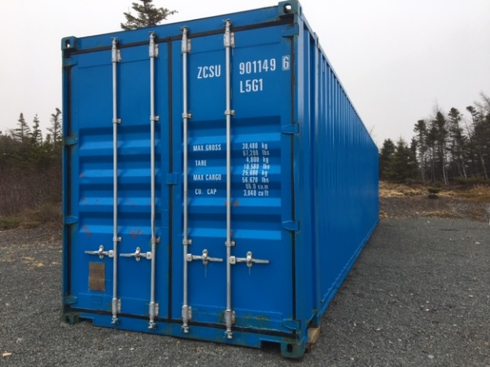
SSC Container Orchestration Framework
SSC CSD Container Strategy
Cloud Native Application Design (Resources and Cautions)
Twelve-factor methodology
Microservice Architecture and Microservices architecture style
CAP theorem
Challenges for a distributed data store to simultaneously provide more than two out of the following three guarantees
Consistency: Every read receives the most recent write or an error
Availability: Every request receives a (non-error) response – without the guarantee that it contains the most recent write
Partition tolerance: The system continues to operate despite an arbitrary number of messages being dropped (or delayed) by the network between nodes
Designing Distributed Systems
Martin Fowler (Microservices and Refactoring)
Domain-driven design
Manifesto for Agile Software Development
Which then leads to a discussion of Serverless, Service Mesh, Software Supply Chain
integrity, zero-trust networking, software defined perimeter… per other DAAN Sessions
i.e. Caution when pulling unknown
images from a public registry
Notes:
https://towardsdatascience.com/cap-theorem-and-distributed-database-management-systems-5c2be977950e

